Slide 1
Call for E-Day CSSE Volunteers. Feb. 24
Time: 30 minutes to 1 hour
Be a host in the student center
CSSE Departmental Tour
Benefits
New skills
Community Serving
Lunch
T-Shirt
Resume
Bonus Points

Slide 2

COMP7500/7506 Advanced Operating Systems
Project 2
A Pipe-based WordCount Tool
Dr. Xiao Qin
Auburn University http://www.eng.auburn.edu/~xqin
xqin@auburn.edu
Notes:
Project 2: Overview and Design

Slide 3
Learning Objectives
I
2
To get familiar with file I/Os in C
3
Use the GDB tool to debug your C program in Linux
5
To design a multi-process program
To learn Unix Pipe - one of the first IPC mechanisms
4
To Implement a C program using ordinary pipes
Notes:
To learn Unix Pipe, which is one of the first IPC mechanisms
To get familiar with file I/Os in C
To design a multi-process program in which there are two cooperating processes
To Implement a C program using ordinary pipes
Use the GDB tool to debug your C program in Linux

Slide 4

Project Overview
We will make use of ordinary pipes enabling two processes to communicate in a producer-consumer fashion.

Slide 5


Read a File
Count Words
Print Result
Two Collaborating Processes
Process 1
Process 2
Process 1
Process 1: Parent
Process 2: Child

Slide 6
Exercise 1: We will implement the WordCount tool as a command-line (i.e., pwordcount). What is (are) WordCount’s argument(s)?
Sample Usage
A File: “input.txt”
“This is the second project of COMP7500 class.”

Slide 7
Sample Usage

Slide 8
Exercise 2: User input should be checked for errors. What error-checking cases should you consider in pwordcount?
Error Checking: Case 1
Case 2: File doesn’t exist
Case 3: File can’t open
Case 4: File isn’t a standard text document

Slide 9
Two Unix Pipes
Parent Process
Child Process
Notes:
Parent Process Creates

Slide 10
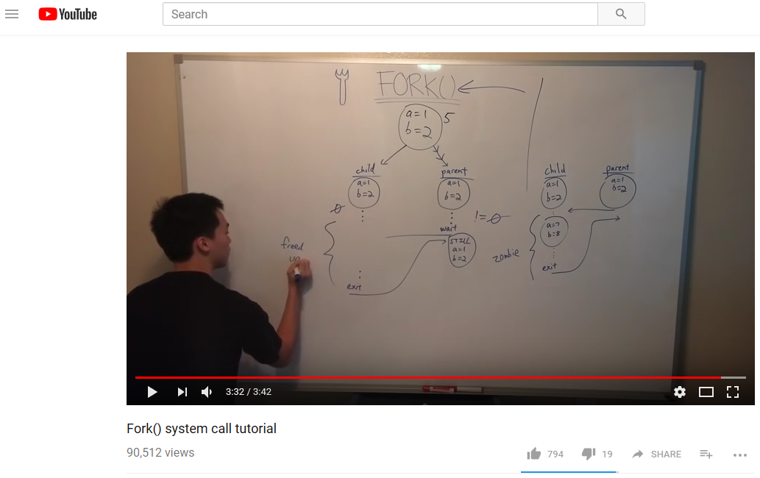
https://www.youtube.com/watch?v=xVSPv-9x3gk
Notes:
Reference: https://www.youtube.com/watch?v=uHH7nHkgZ4w

Slide 11
Step 1: Creating a Child Process
Exercise 3.1 (Plickers): What is the value of child process pid?
Exercise 3.2: What is the output of this program?
Notes:
Parent Process Creates

Slide 12
Notes:
Parent Process Creates

Slide 13
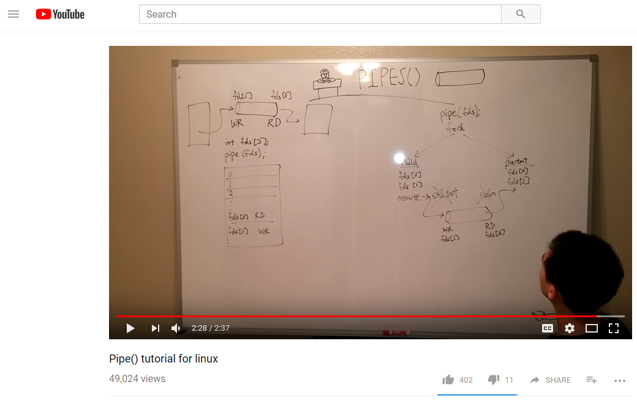
https://www.youtube.com/watch?v=uHH7nHkgZ4w
Notes:
Reference: https://www.youtube.com/watch?v=uHH7nHkgZ4w

Slide 14
Step 2: Creating Pipes
Exercise 4 (Plickers):
4.1 What is the data structure of fd?
4.2 Is fd an input or output of pipe() or it is an error code?
Notes:
Parent Process Creates

Slide 15
Exercise 5 Plickers:
A) Must be closed before writing to the pipe.
B) READ_END hasn’t yet been opened
C) We finish using READ_END
D) It is an unused end of the pipe
Why close fd(READ_END)?
Notes:
Parent Process Creates

Slide 16
Exercise 6
What are the three arguments in read()?
Notes:
Parent Process Creates

Slide 17

Step 3: Loading an Input File
To implement the parent process that
(1) opens and loads a file and
(2) delivers data to the child process.

Slide 18

Step 4: Counting Words
To implement a WordCount function.
To conduct a unit test of this function prior to carrying out the next step.

Slide 19

Step 5: Integration
To integrate your wordcount function with the two pipes.

Slide 20

Step 6: Testing
To test your program using various input files (e.g., small and large files).

Slide 21

What’s Next?
Homework: design a data flow diagram
Review sperate compilation
Notes:
Cont. ch3.ppt, slide 44 Synchronization

Slide 22

Summary
What are the learning objectives?
What are Unix pipes?
How to use fork()?
How to use pipe()?
Notes:
Cont. ch3.ppt, slide 44 Synchronization

Slide 23

Separate Compilation (Optional Requirement)
Who?
What?
To practice separate compilation using make
How?
To following the instructions in Section 5
You are unfamiliar with separate compilation
Notes:
Primitives are defined as:
send(A, message) – send a message to mailbox A
receive(A, message) – receive a message from mailbox A

Slide 24
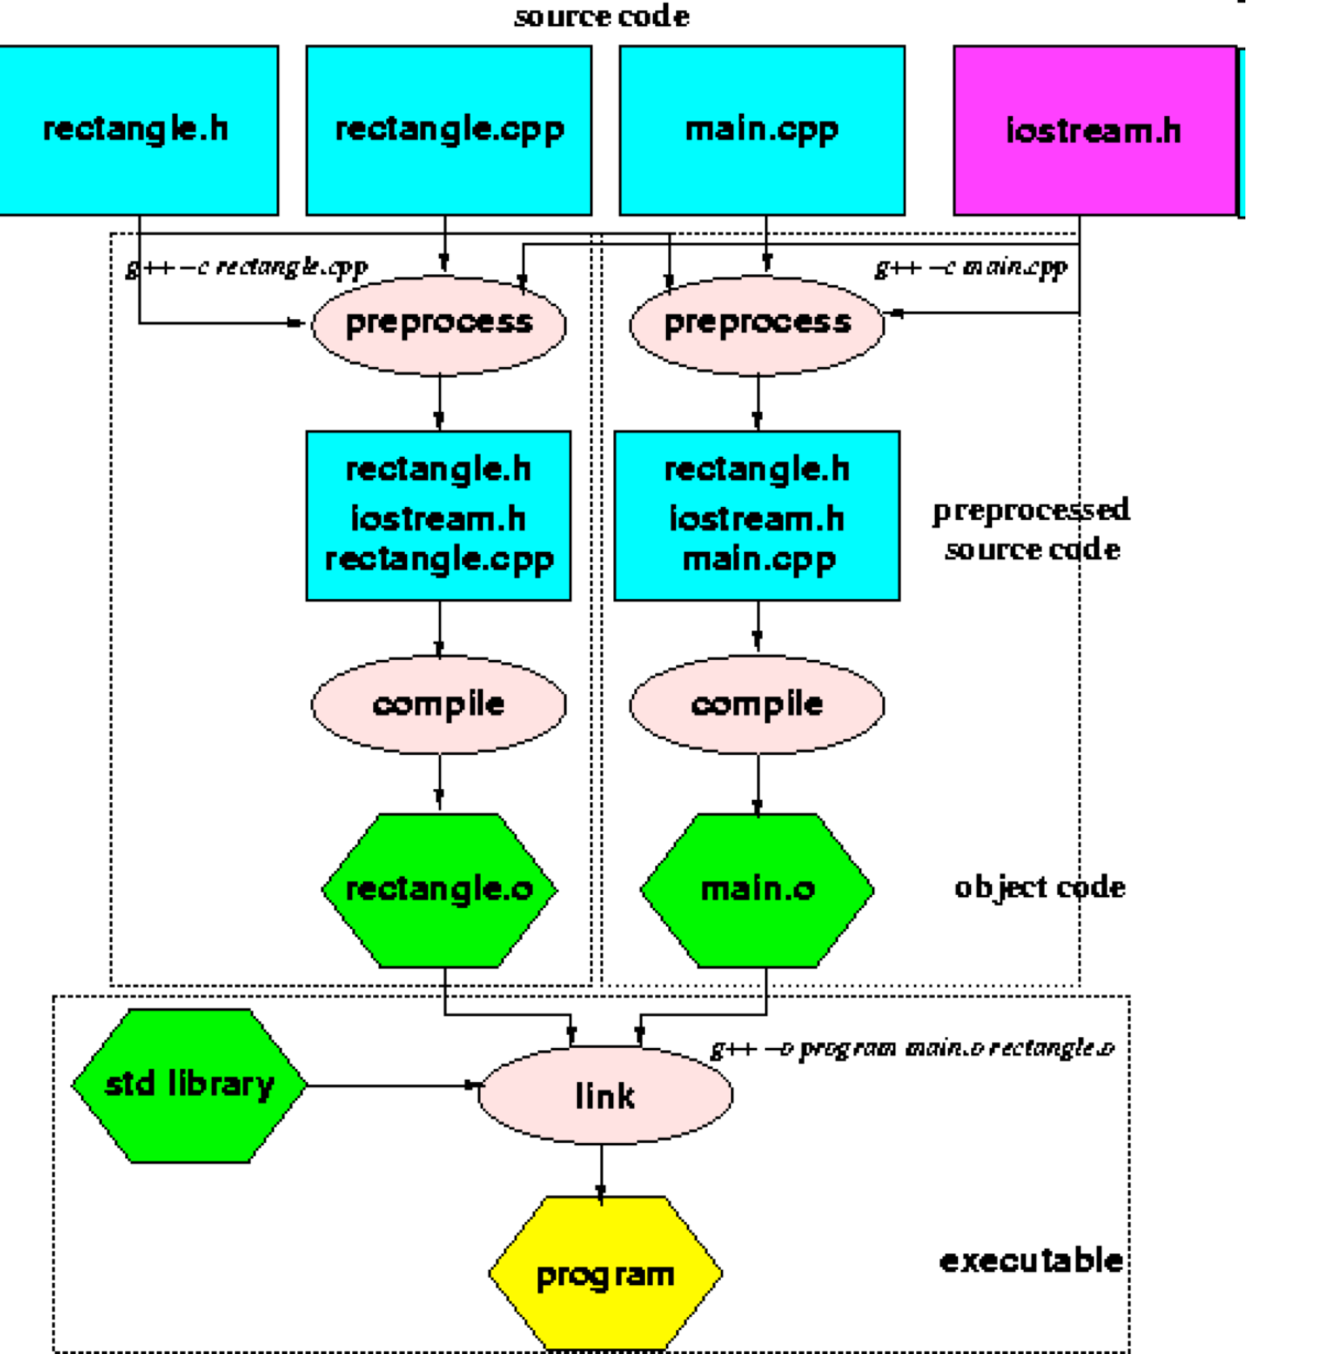
Separate Compilation
Notes:
Linux Kernel Grows Past 15 Million Lines of Code.
Makefiles provide a way for separate compilation. When a file from a project is changed, only the files that depend on the changed file are compiled.

Slide 25
An Example
dtime.h dtime.c timedemo.c
gcc -c dtime.c
gcc -c timedemo.c
gcc dtime.o timedemo.o –o timedemo
Makefile
The make Utility Program

